Slide 1
Clustering New York City Neighborhoods
Applied Data Science Capstone

Slide 2
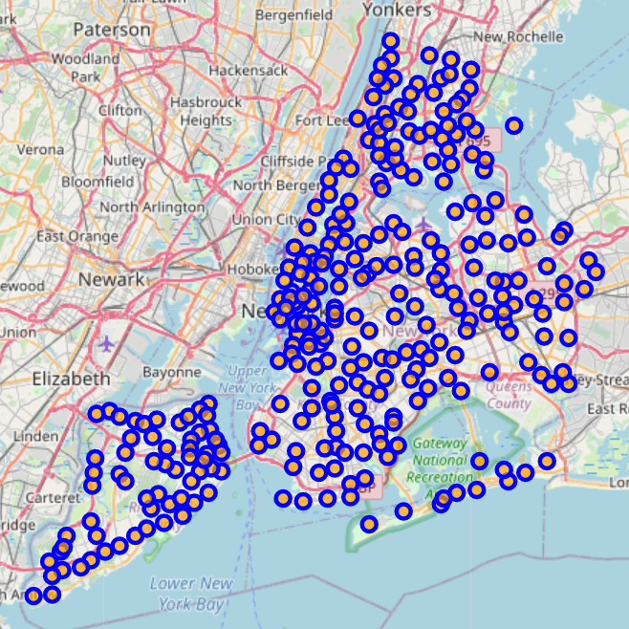
New York City is massive
Moving to NYC can be a daunting task
Almost 300 neighborhoods exist in the 5 boroughs
How can we group like neighborhoods, whether to visit or move?

Slide 3
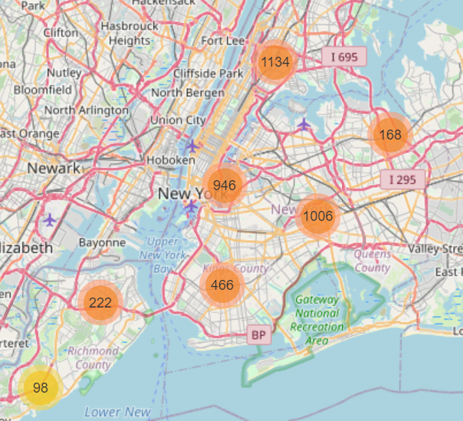
Park system
New York has a vast park system, with over 2,000 parks
In a major city, access to a park is key, especially if you have a dog

Slide 4
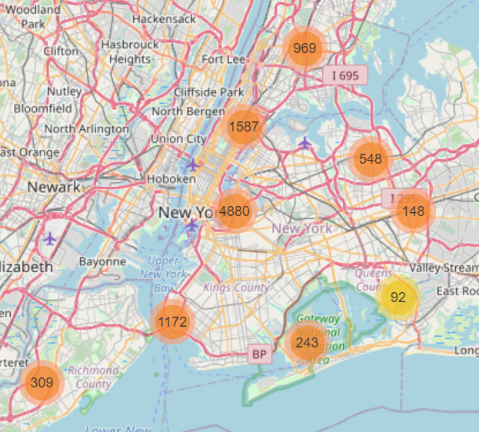
Venues to match its reputation
As you would expect, NYC has an almost limitless amount of venues
The map to the right has almost 10,000, and that limited counts to 100 for each neighborhood!

Slide 5
Clustering NYC
To compare neighborhoods, we can use the following data:
A list of neighborhoods
Number of parks within walking distance
Size of the parks within walking distance
Number of venues within walking distance
Count of the unique venue types
Using K-Means clustering, we can separate the neighborhoods into 5 categories. The following slides have more details

Slide 6
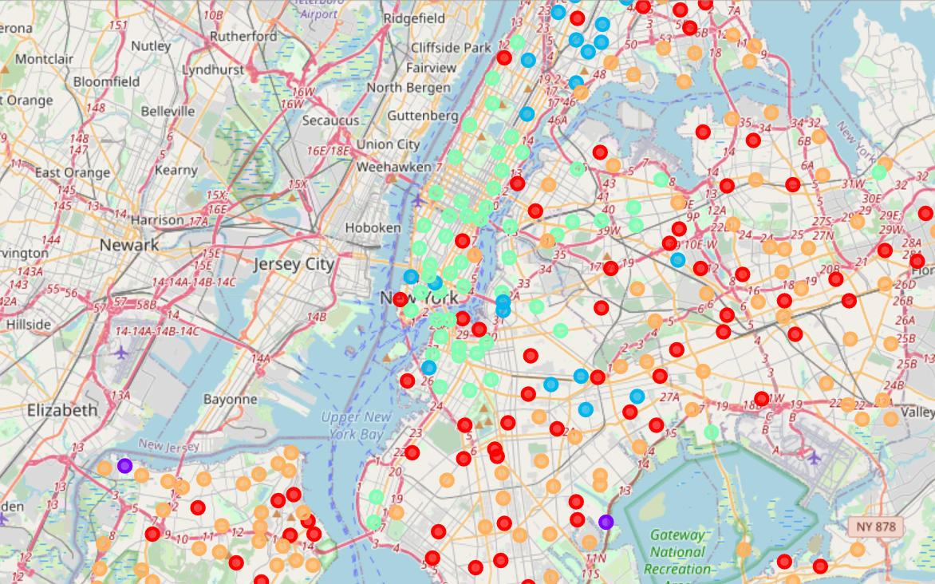
Cluster map

Slide 7
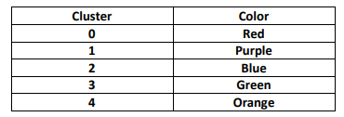
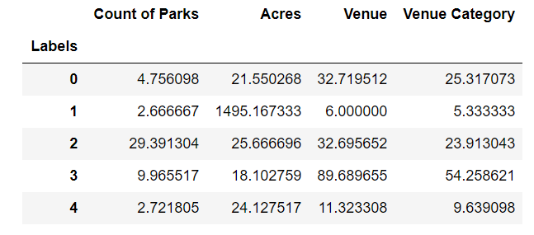
Cluster details

Slide 8
conclusion
Hot Brooklyn and Queens neighborhoods (Astoria, Jackson Heights, Williamsburg, Park Slope, etc.) are very Manhattan-like
Plenty of venues, somewhat limited outdoor space
Outer borough neighborhoods offer more outdoor space and would offer a balance
Some outer borough neighborhoods lack venues

